Slide 1
Flight Performance System (FPS)
Slot Consulting | RSZ INFO

Slide 2
ABOUT US
Slot Consulting
  Aviation research & development / consulting company
RSZ INFO
  ICT consulting / development company

Slide 3
INFORMATION
Genaral Information:
  General aviation pre-flight performance calculation/optimization solution
  Weight & Balance
  Runway (take-off/landing) performance
  Climb performance
  Cruise performance
  Descent performance

Slide 4
BENEFITS
  Purely based on AC’s FM’s/POH’s
  Provide the fastest and best consumption (green) flight levels
  Integrated with weather providers
  Easy to add routes based on ICAO flight plans

Slide 5
WHY?
  It is a must to do such calculations – in case of commercial flights
  It provides not only a minimum calculation, but optimization also
  Calculates the route on all available flight levels and provides the fastest and the best consumption ones

Slide 6
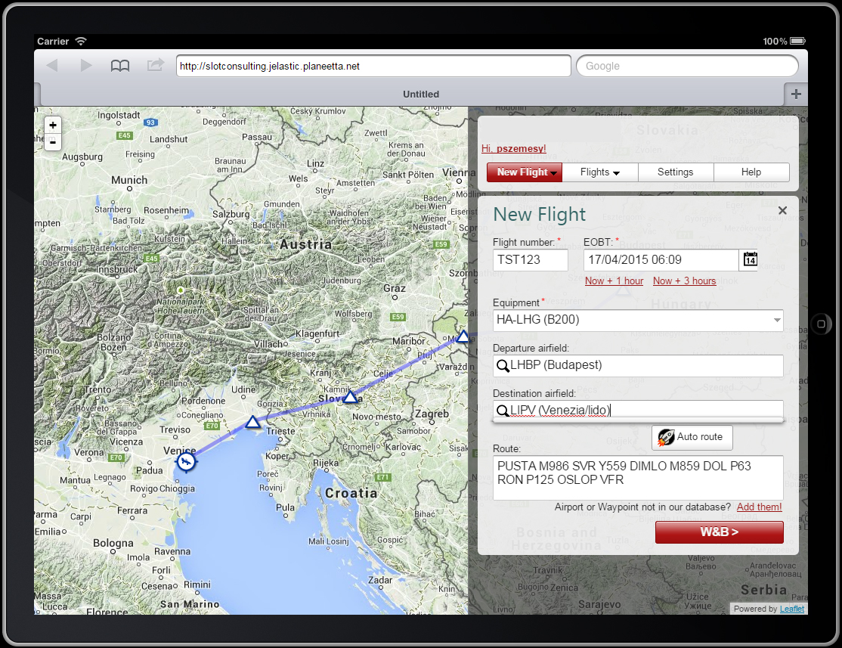
ROUTE SETTINGS

Slide 7
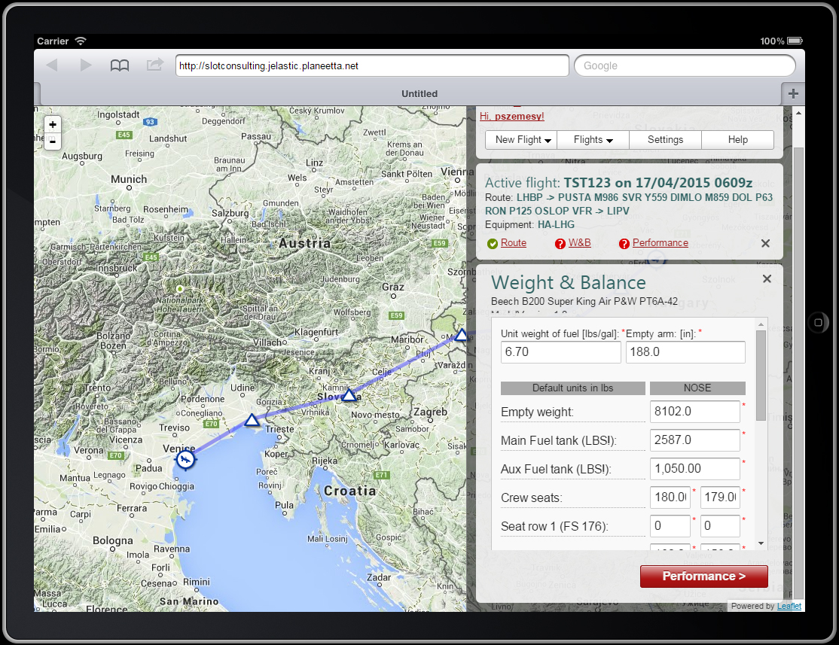
WEIGHT & BALANCE SETTINGS

Slide 8
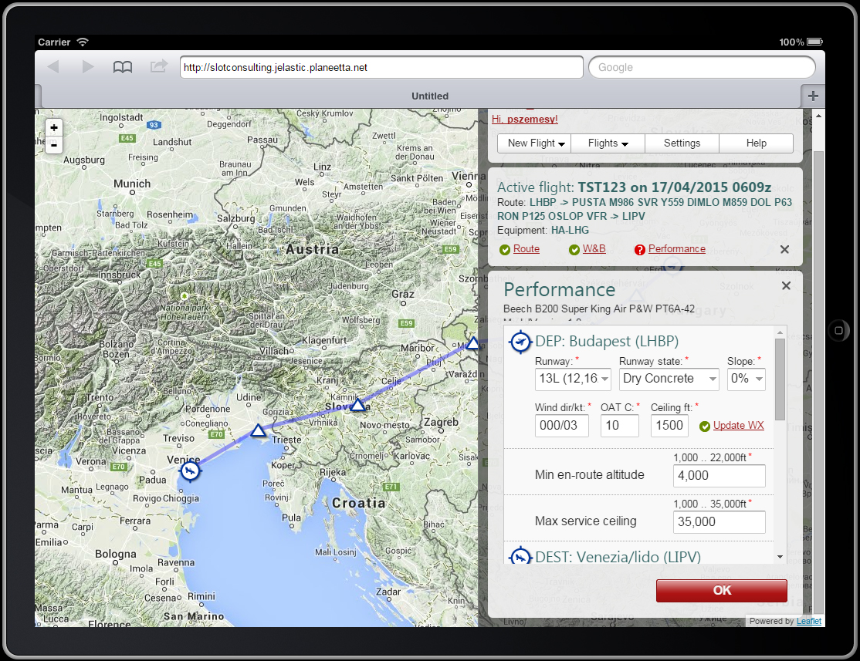
PERFORMANCE SETTINGS

Slide 9
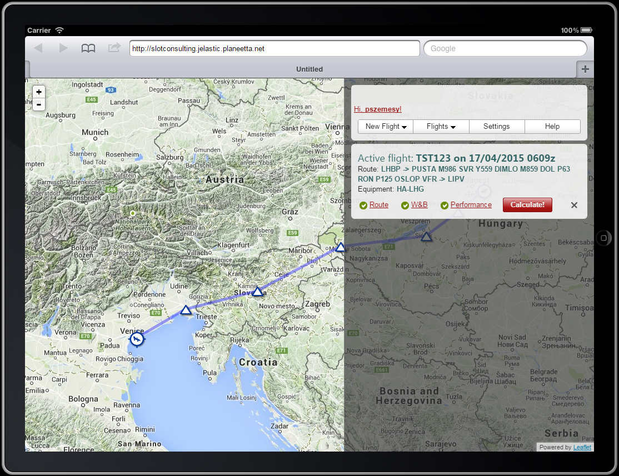
WEIGHT & BALANCE SETTINGS

Slide 10
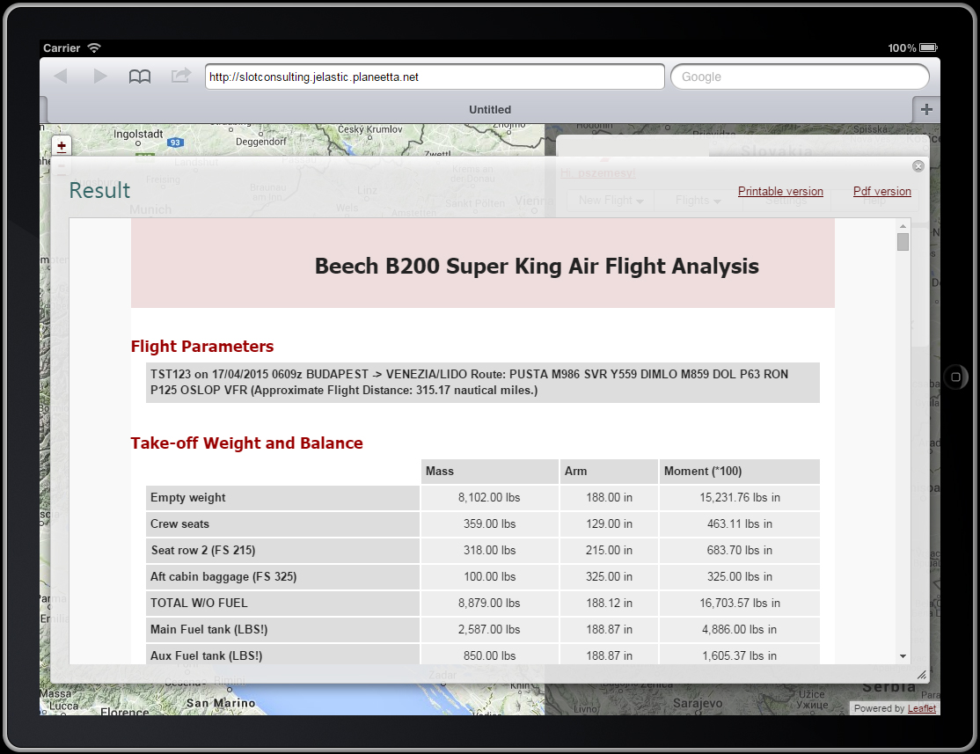
RESULTS

Slide 11
BENEFITS
Fast
Efficient
Integrated
Easy to handle

Slide 12
WHY FPS?
Fly Smart.
Does all the calculations Instead of You.
Save Fuel:
  Save your money.
  Save the Planet.

Slide 13
CONTACT US
rolandguraly@slotconsulting.hu
www.slotconsulting.eu
Thank you. Have a great day!

